Slide 1
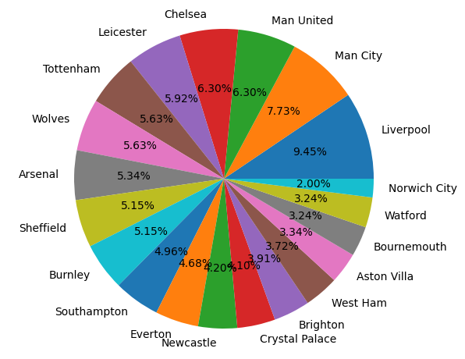
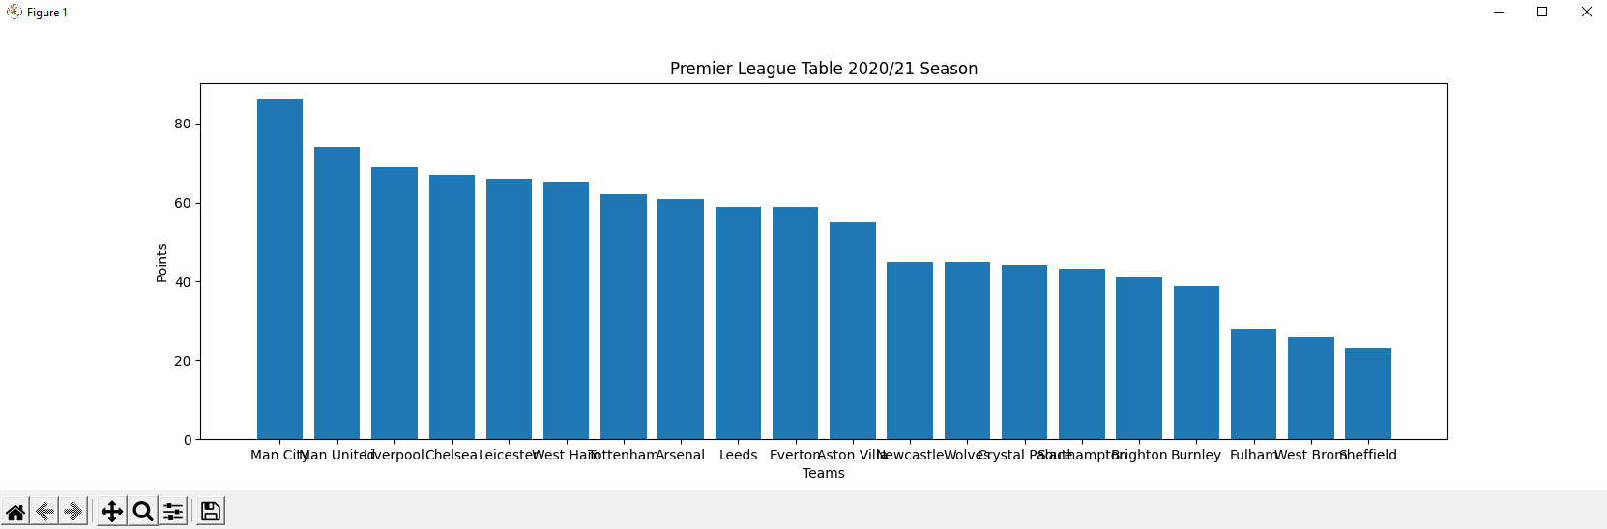
Visualisations of the Premier League points table
This section shows multiple methods of visualisation which I have used to represent the Premier League points table. For this, I took data from 3 different seasons which can be used to show how each team played overall, such as how they may have improved over the years, or how they have fallen short. This data also shows what teams have been relegated from the Premier League, and what teams have been promoted to the Premier League over these seasons and moreover, how well they perform in the Premier League.
I have derived this data from the 2018/19 season, the 2019/20 season and the 2020/21 season.
Coded Visualisation
Worded representation
Euan Ibbotson

